Slide 1
Opportunity Pipeline Forecasting
Spring board Project
Case Study
Confidential
19-Jan-2023

Slide 2
Topics/Agenda
01
｜
Problem Statement
02
|
Data description
03
|
Data Preprocessing
04
|
Exploratory Data Analysis
05
｜
Model Building

Slide 3
01
Problem Statement

Slide 4
The client is a technology and chip manufacturing company. The sales group of the client have annual targets in $ that they need to sell. The client team is trying to achieve those targets by pursuing multiple opportunities across customers and business segments.
It is identified that, while a number of opportunities are being pursued, the sales group is lacking to quantify the potential of conversion of opportunities within a specific timeframe.
Our objective is to quantify the conversion potential of a sales pipeline portfolio, it can be realized by quality of an opportunity.
An opportunity: It is defined as a potential customer with specific asks of products in type, design and quantity with their $ values negotiated
Quality of an opportunity: How likely is an opportunity to convert within a specific timeframe?

Slide 5
02
Data Description

Slide 6
Opportunity Table
The data provided by the company is all Opportunities along with relevant product sells, across different customers from 2015 to 2016 - Q3
Provided with the opportunity ID
Transition from stage and to stage
Timestamps of the transition to and transition from stage
Name of the customer
Risk status of the opportunity
Opportunity creation and decision date
Opportunity status (whether it is open or closed/won or closed/lost)
Core consumption market
Core product segment
Core sales segment
Geography
Core product application

Slide 7
Understanding Pipeline Portfolio
6: Qualify
5: Define
3: Develop
2: Design
4: Design Win
Production Win
An opportunity can enter pipeline at any stage.
If an opportunity reaches Design Win or production win, consider it as closed/won.
If an opportunity is cancelled or lost, consider it as closed/lost.
If it is in between stages then opportunity is open.

Slide 8
Transaction Table
In Transaction table, we have following features
Opportunity ID
Product ID
Product Segment Name
Product status
Product $: negotiated amount
Product quantity: quantity of the multiple products customer wants to buy
Decision date: a decision should be taken before this decision date
Snapshot time

Slide 9
03
Data Preprocessing

Slide 10
Data Cleaning
Cleaned and merged datasets
Converted transition timestamps and snapshot time to datetime objects.
Encoded 'transition to stage', 'transition from stage name', 'customer name', 'risk status', 'opportunity status', 'core consumption market' and 'core product segment’, ‘geography’, ‘product status’ and 'opportunity type' as numerical values.
Removed duplicate rows.
Dropped product segment name column as it has only one unique value.
After cleaning both datasets, we merged them using inner join on opportunity ID and decision date.

Slide 11
Feature Engineering
Created ‘time taken for decision’ (in days) by subtracting first time opportunity entered pipe from first time when it first had opportunity status as win/loss.
Created ‘cost per product’ by dividing ‘product $’ and ‘product quantity’.
Created ‘diff_avgcost’ that represents the difference between average cost and actual cost per product of an opportunity
Created ‘decision days’ that represents difference between creation date and decision date in days.
Created ‘transition days’ that represents the time taken for an opportunity to transition from one stage to another.
Dependent Variable
Opportunity status is dependent variable.
For a particular opportunity, opportunity status is first na, then it changes to open after some transitions and finally to win or loss. So we changed opportunity to final status for that opportunity.
We consider closed/win as 1 and other status like closed/lost and open as 0 and created different dataset for entries where final status is open and prediction opportunity status for this dataset using our trained model.

Slide 12
04
Exploratory Data Analysis

Slide 13
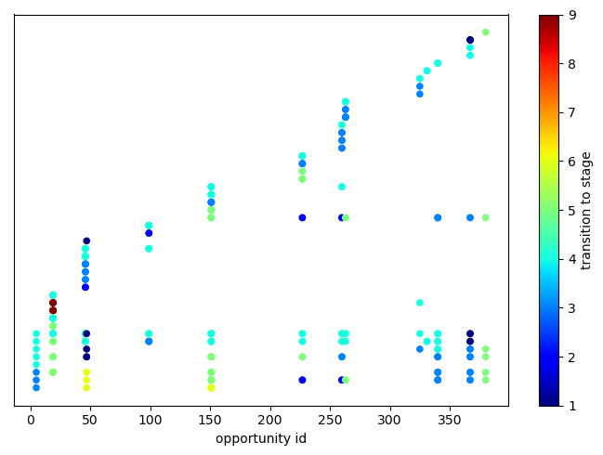
Movement of Opportunities through Stages
Here this plot shows movement of some opportunities through stages using colour map.
There opportunity id is plotted against transition to timestamp coloured according to stage number.
From here we can see that a particular opportunity usually transition between only 2-3 stages.

Slide 14
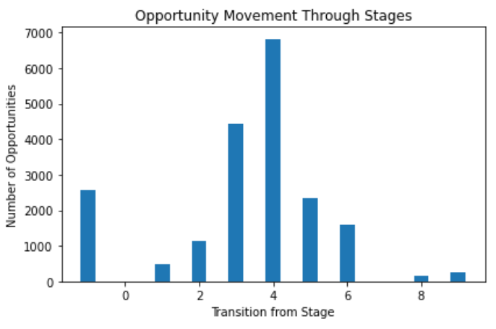
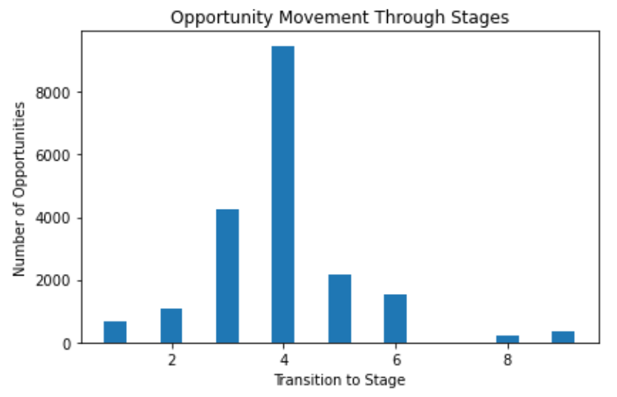
Transition between Stages
Here we plotted bar graph to understand how transition between stages is happening.
Here most opportunities are able to go to stage 4 (design win) but a few are able to get to stage 9 (production win)

Slide 15
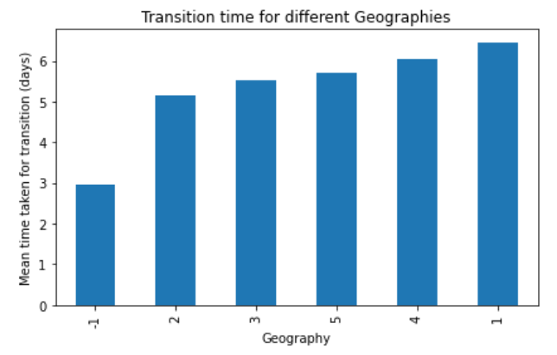
Stage Transition and Geographies
Here different geographies and mean transition time for each geography is plotted.
Here bar graph shows how mean transitional time varies for different geographies with maximum time taken in geography 4 and minimum in 2, as we are ignoring geography 1 and -1.
2.96
5.16
5.51
5.71
6.05
6.45

Slide 16
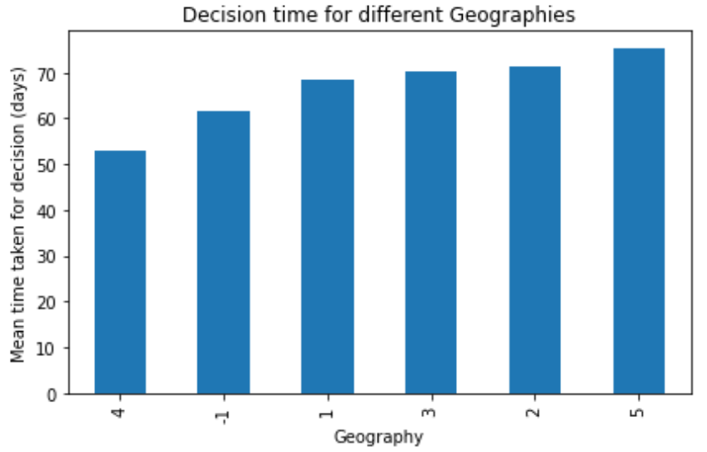
Decision Time and Geographies
For this analysis, we have different geographies and mean decision time for each geography.
Mean time taken for decision varies for different geographies with maximum time taken in geography 5 and minimum in 4. We are ignoring geography 1 and -1.
To further support this hypothesis, we performed ANOVA test and p-value comes out be 1.12e-79.
2.96
5.16
5.51
5.71
6.05
6.45

Slide 17
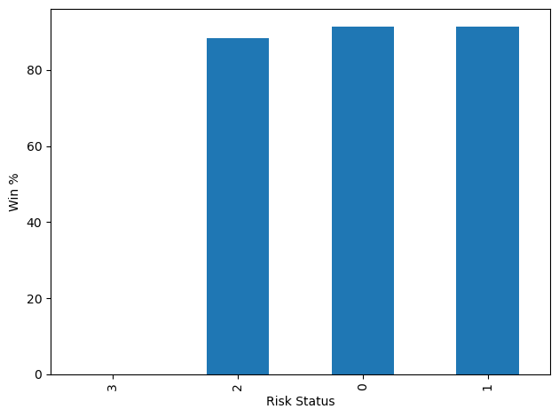
Risk Status
For this analysis, we have win percentage for different ‘risk status’.
Here we have most values in 0 (NA) because initially every opportunity is 0, then it got converted into other values.
P-value comes out to be 4.79e-7 (chi-square)
Risk Status | 0 | 1 | 2 | 3
Status
False | 1449 | 255 | 5 | 3
True | 15265 | 2740 | 38 | 0

Slide 18
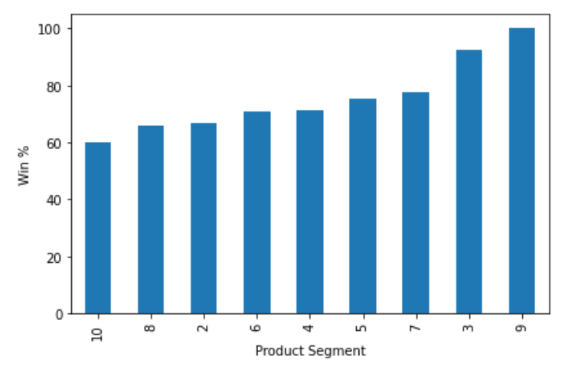
Wins and Product Categories
For this analysis we have 11 product and opportunity status true implies win.
P-value comes out to be 0 (chi-square)
No value in category 10, maybe new category.
Here most opportunities are from product category 3. We can try to diversify in other categories also that are also performing really well like category 9 have 100% success rate.
11
Product Cat | 2 | 3 | 4 | 5 | 6 | 7 | 8 | 9 | 11
Oppr Status
False | 4 | 1438 | 135 | 52 | 16 | 12 | 53 | 0 | 2
True | 8 | 17335 | 338 | 158 | 39 | 42 | 102 | 18 | 3

Slide 19
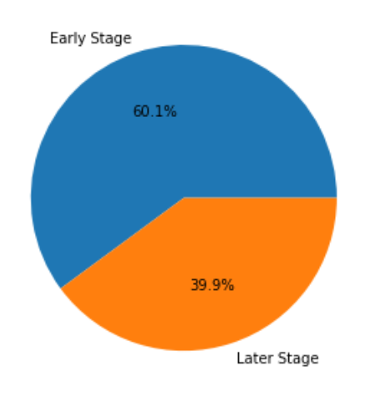
Losses in Early Stage
For this analysis, we defined stage 6 and stage 5 as early stages and other stages as later stage.
Here opportunity status True means loss.’
We calculated percentage of opportunities lost in early (11.9%) and later stage (7.9%) and plotted pie chart for it.
Performed Chi-Square test to test dependency of Loss and stage (early or later).
P-value comes out to be 7.13e-15
Transition to stage | Early Stage | Later Stage
Opportunity Status
False | 3266 | 14777
True | 442 | 1270

Slide 20
05
Model Building

Slide 21
Data Preparation
Target class is imbalanced, so we did over-sampling using smote first to (60-40)% then finally to (50-50)% to reduce distortion.
After balancing target, we performed one-hot encoding and dropped columns like transition to and from stage 4, 9, 1 and 8 to avoid data leakage and geography na and 1.
Dropped columns like ‘product $’ to avoid multicollinearity.
Opportunity Status | Value Count | Class % | Class% after 1st oversampling | Final Class %
1 | 13871 | 91.0 | 60 | 50
0 | 1373 | 9.0 | 40 | 50

Slide 22
Modelling
After Data Preparation for modeling, we trained two models Random forest model and XGBoost model. For both models we first trained model on all features then found feature importance for our features, fine tune our models using GridsearchCV method.
After fine tuning best parameters for random forest model comes out to be gini as criterion, max_depth 6, max_features ‘auto’ and ‘n_estimators’ as 200.
For XGBoost model, best parameters for model came out to be gini as criterion, max_depth 6, max_features ‘sqrt’, learning_rate 0.1 and ‘n_estimators’ as 200.
Then trained model on fine tuned model using important features.
Most important feature comes out to be:
Time taken for decision, decision days, sales segment, product quantity, transition days and cost_per_product for random forest model.
Core Product segment, risk status, Core sale segment, transition days for XGBoost model.

Slide 23
Model Comparison
metric | accuracy | f1_score | log_loss | precision | recall | roc_auc | balanced_accuracy
estimator (0) | 0.837400 | 0.837400 | 0.464445 | 0.837900 | 0.837400 | 0.919100 | 0.837800
estimator (1) | 0.996300 | 0.996300 | 0.038074 | 0.996300 | 0.996300 | 0.999900 | 0.996400
estimator(0) : random forest classifier estimator(1): xgb classifier
# | actual_0 | actual_1
predicted_0 | 10761 | 1835
predicted_1 | 2249 | 10267
# | actual_0 | actual_1
predicted_0 | 12935 | 17
predicted_1 | 75 | 12085

Slide 24
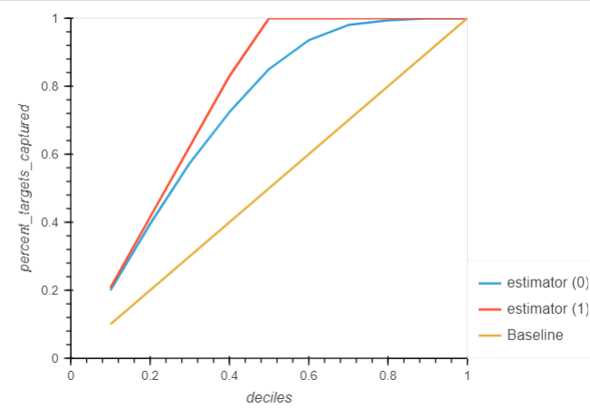
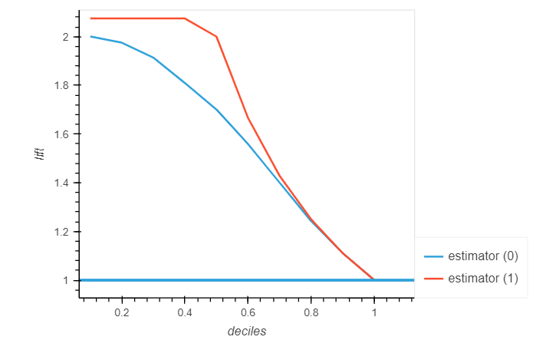
Gain Chart
Lift Chart
The lift chart shows, by selecting the 40% records based on the model, one can expect 2 times the total number of targets (events) found by randomly selecting 40%-of-file without a model for the estimator(1) and 1.9 times for estimator(0).
The gain chart shows a sharp increase above the reference line, then a flattening. In this case, approximately 50% data account for approximately 85% of the positives target for estimator (0) and 100% for estimator(1)

Slide 25
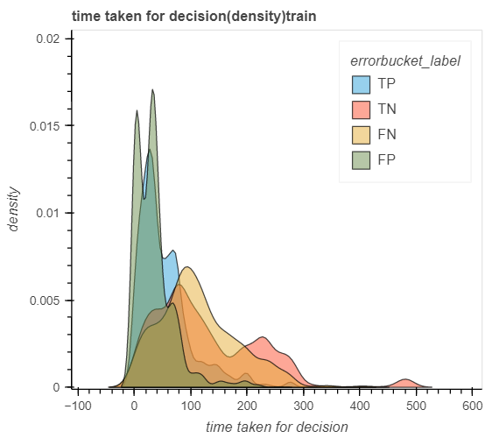
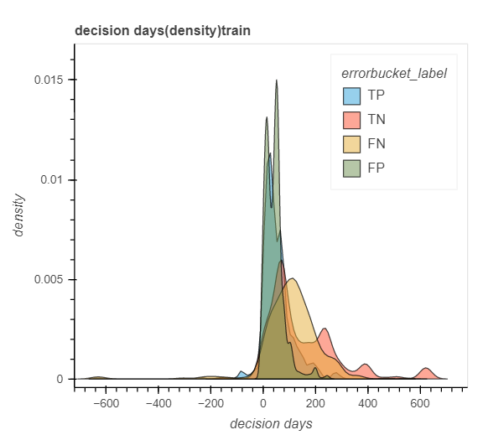
Misclassification Analysis
These graphs are for random forest model. Time taken for decision and decision days comes as most important feature.
From below graph we can see that,
some negatives which are taking less time for decision are misclassified as positives, the same trend is followed in decision days.
Positives which are taking more time to make decision are misclassified as negatives

Slide 26
Business Insights
Most of our opportunities aren’t reaching production win stage, we can find reason and try to take opportunities to Focus more on production.
Mostly opportunities which take less time for decision are more likely to be win, so we can try to speed up transition between stages and focus on geographies like geography 5 to reduce decision time.
Most opportunities are from core product segment 3, we can look to diversify it. It seems like segment 10 and 11 are new, and no opportunity of segment 10 is completed.
Other segments are also doing good like core product segment 9 has 100% success rate, but little opportunities in this segment we can look for more opportunities in this segment.
We are taking too much time to assign proper risk status.

Slide 27
Thank You
Do you have any questions?
Presented by:
Atanu Mandal
Eswar Ungarala
Janaki Guggilla
Kirandeep Kaur

